Slide 1
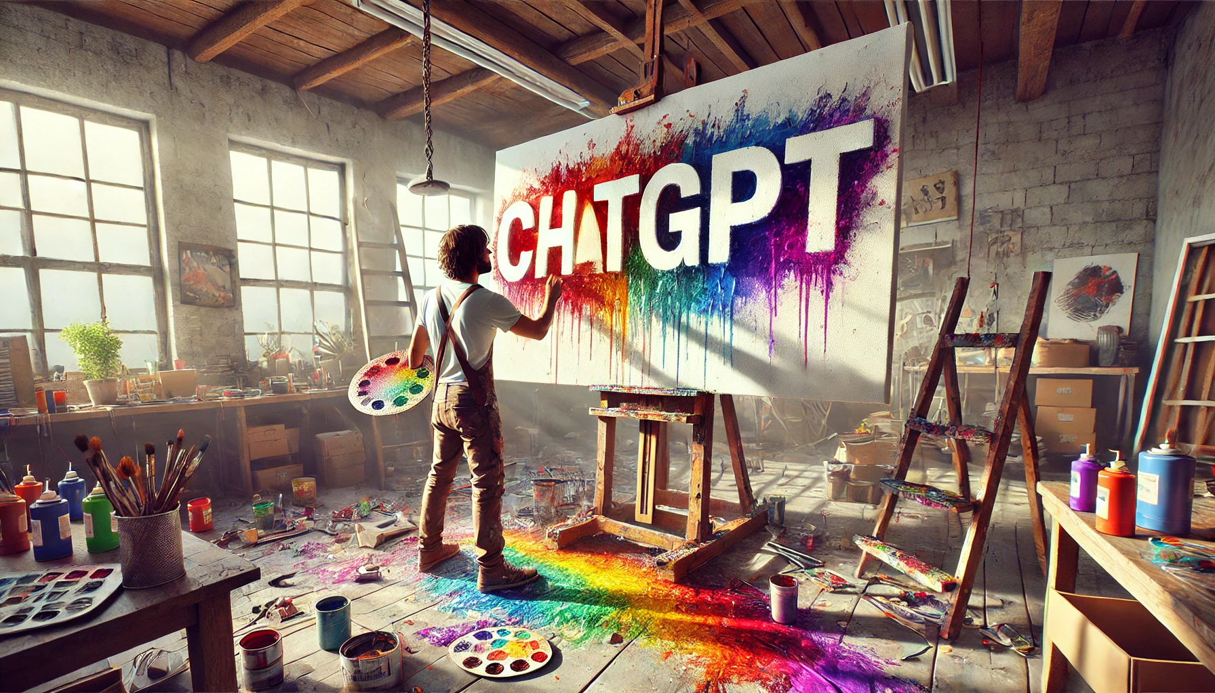
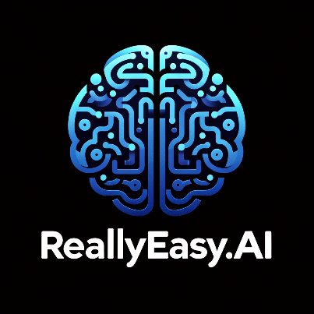
How to Really Use
ChatGPT 4o
With Canvas

Slide 2
What you will learn
What is Canvas?
Comparing it to Claude Artifacts
Working with Text
Working with Code

Slide 3
What is canvas?

Slide 4
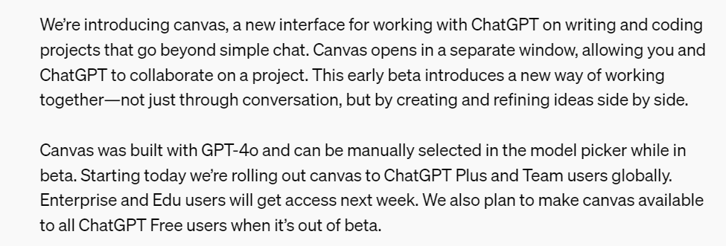
What is canvas?
Notes:
https://openai.com/index/introducing-canvas/

Slide 5
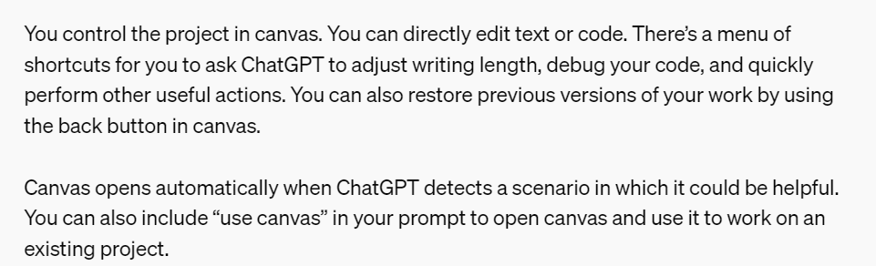
Notes:
https://openai.com/index/introducing-canvas/

Slide 6
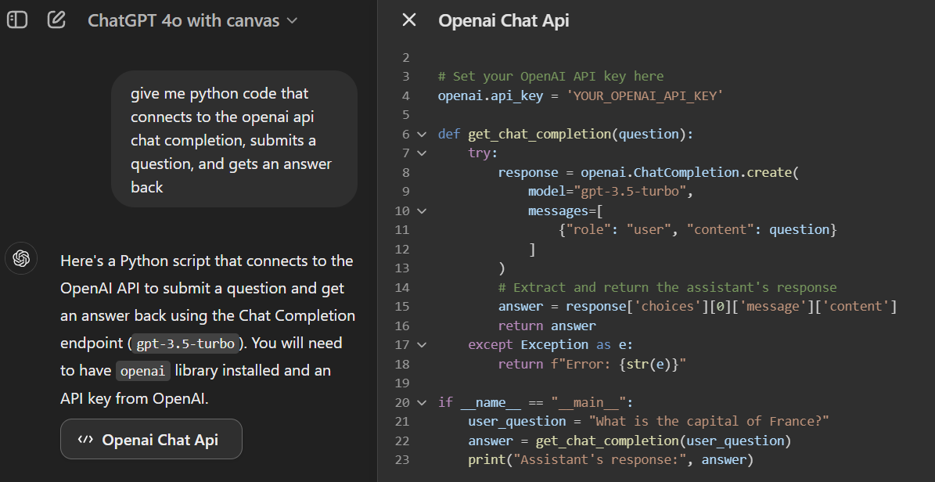
Demo: Quick Look at canvas
Notes:
Give me python code that connects to the openai api chat completion, submits a question, and gets an answer back

Slide 7
Comparing it to Claude artifacts

Slide 8
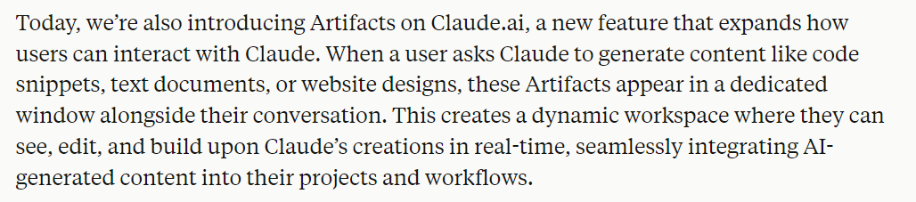
Claude artifacts
Notes:
https://www.anthropic.com/news/claude-3-5-sonnet

Slide 9
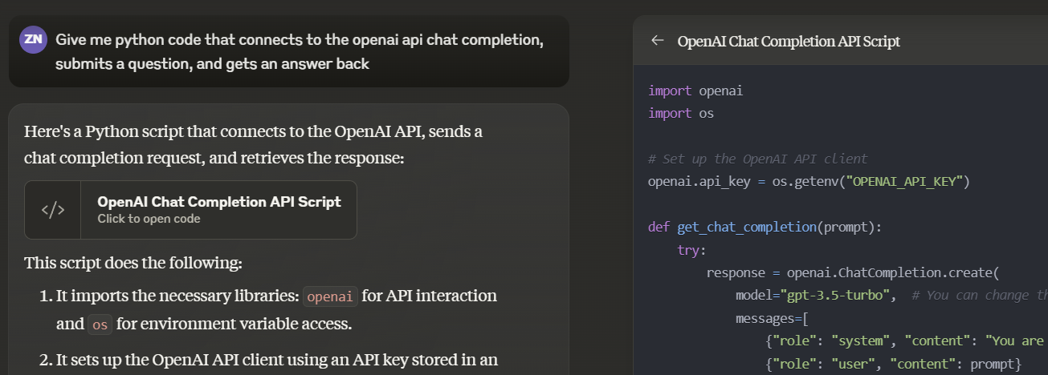
Demo: Claude artifacts
Notes:
Give me python code that connects to the openai api chat completion, submits a question, and gets an answer back

Slide 10



Notes:
https://www.youtube.com/channel/UC35ZpwldGw7ZJ5R-2sLijzw

Slide 11
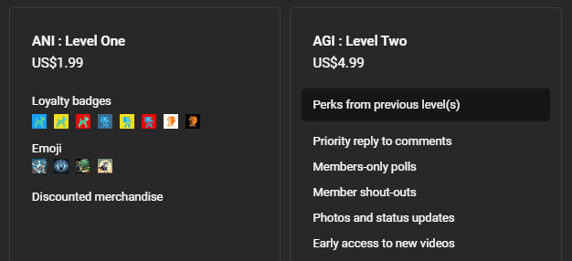
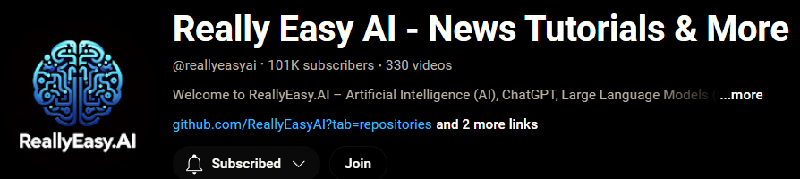
Become a member!
Notes:
https://www.youtube.com/channel/UC35ZpwldGw7ZJ5R-2sLijzw/join

Slide 12

https://www.youtube.com/@AINewsFresh

Slide 13
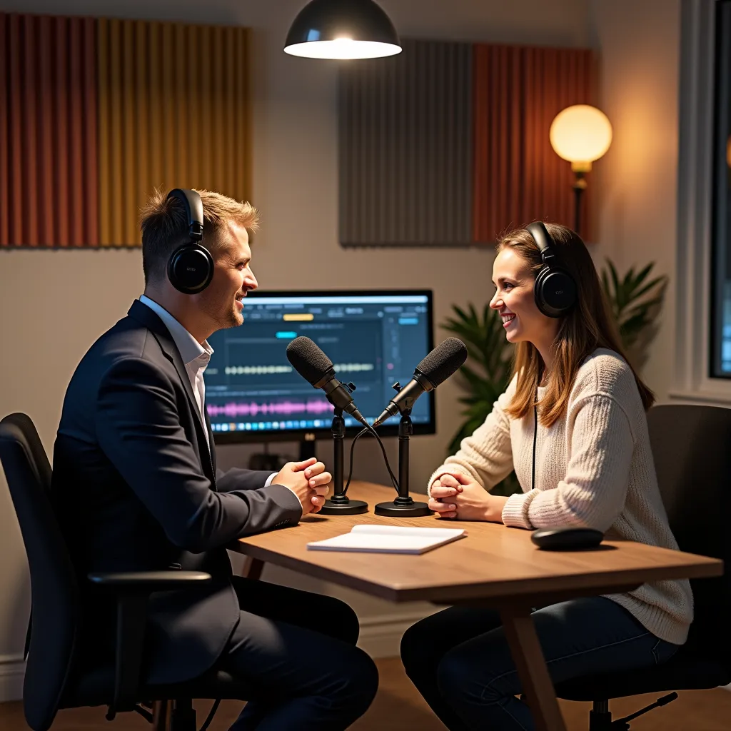

https://www.youtube.com/@DailyAINewsPodcast

Slide 14
Working with text

Slide 15
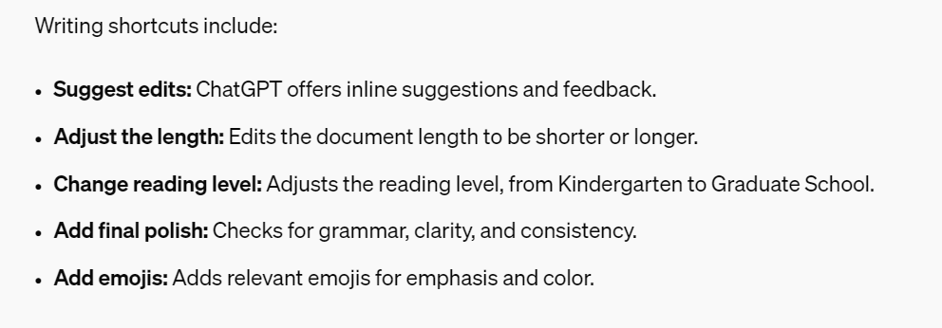

Slide 16
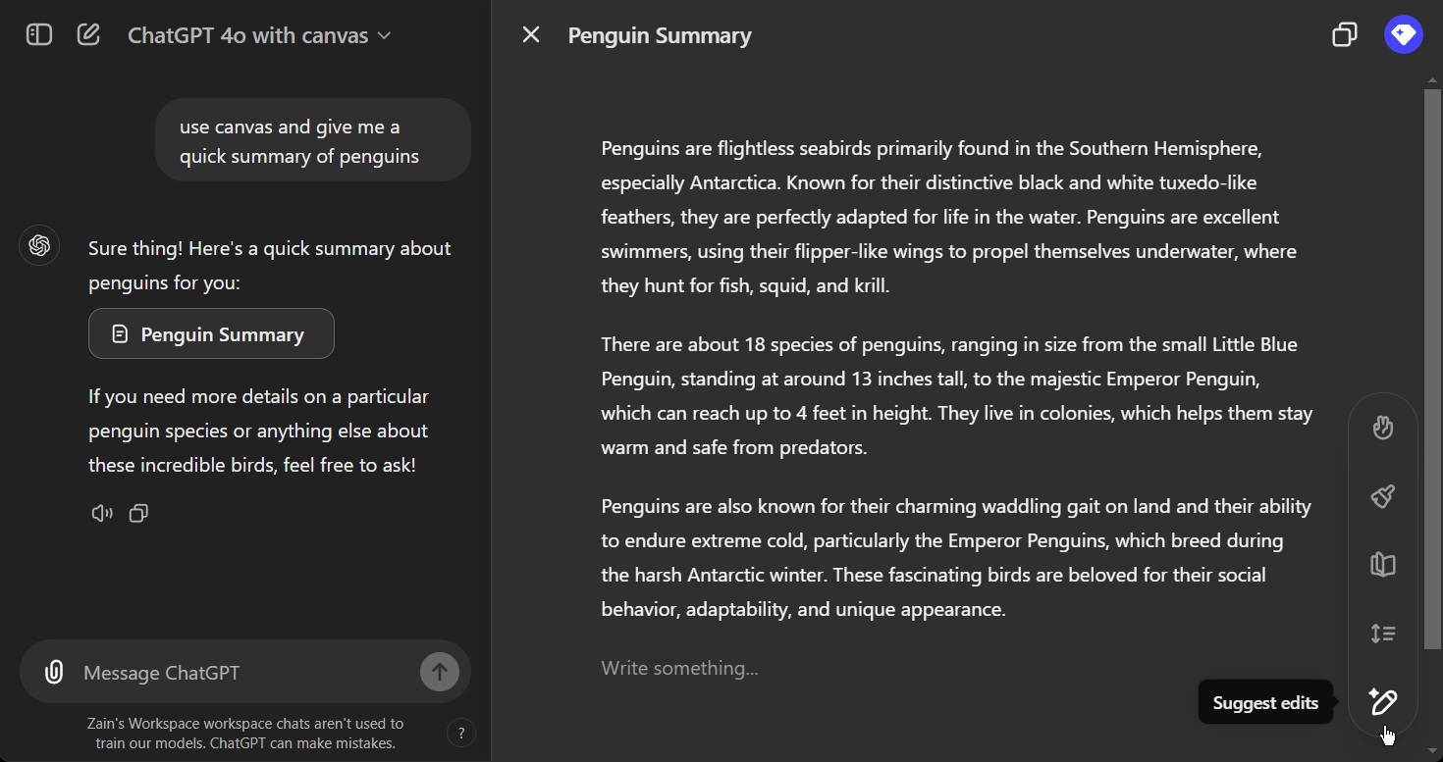
Demo: working with text
Notes:
Use canvas and give me a quick summary of penguins

Slide 17
Working with code

Slide 18
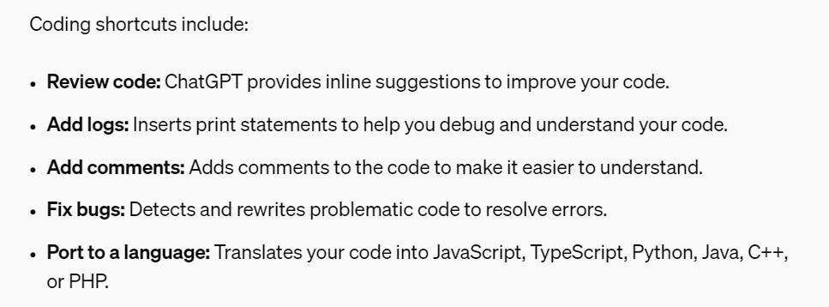

Slide 19
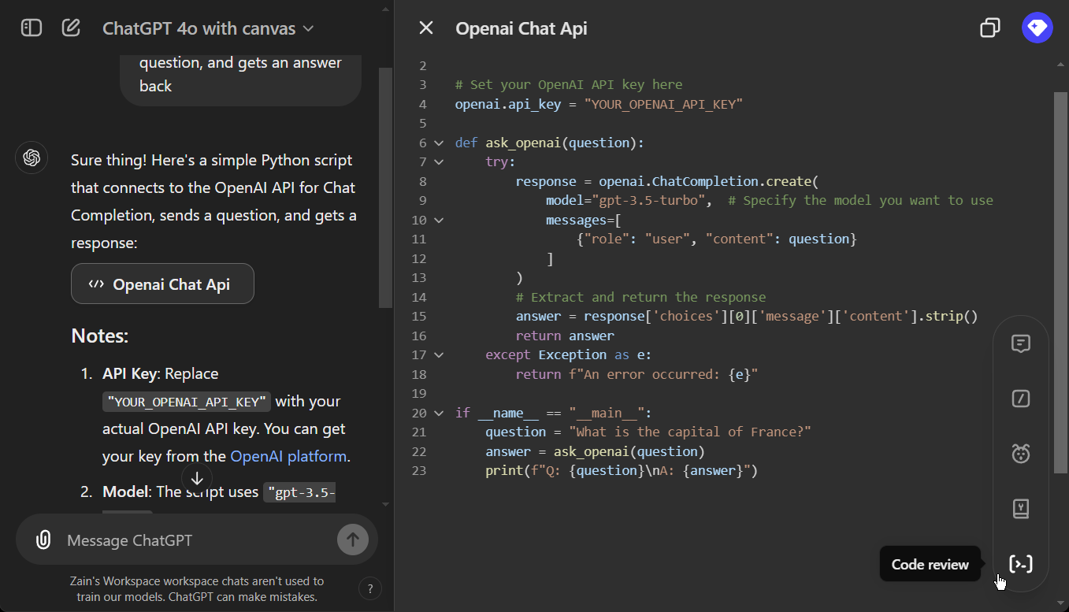
Demo: Working with code
Notes:
Give me python code that connects to the openai api chat completion, submits a question, and gets an answer back

Slide 20


